Slide 1

MINI PROJECT PRESENTATION
Medical Expert
System For
Disease Prediction
Under the supervision of Prof. Vrijendra Sir

Slide 2

OUR TEAM
Ritesh Kumar Gupta IIT2021135
Pankti Salvi IIT2021134
Sneha Choudhary IIT2021132
Gaurav Singh IIT2021120
TUSHAR KUMAR IIT2021203

Slide 3

Table of
CONTENTS
01
02
03
04
05
Problem Statement
Need of the Medical Expert System
Dataset Generation
Data Analysis
Flowchart of our system
06
07
08
09
10
Proposed Methodology
Results
Future Scope and Conclusion
Activity Timechart
Acknowledgements and
References

Slide 4

PROBLEM STATEMENT
The medical expert system aims to predict diseases and recommend medications based on reported symptoms.
It addresses the challenges of limited healthcare access, misdiagnosis, and the need for timely and accurate disease identification.
Motivations include improving access, minimizing misdiagnosis, educating users, optimizing resource allocation, and enabling continuous learning.
However, it's crucial to note that the system is a supportive tool and should not replace professional medical advice.

Slide 5
NEED OF THE
MEDICAL EXPERT SYSTEM
There are many areas in our country where doctors are not always available. With the use of this expert system, it is not necessary to consult with a doctor for every single sickness.
Many people in our country cannot afford the costs associated with seeing doctors. As a result, they avoid consulting with doctors and instead go to a medical store and buy medicine without first ensuring that it is appropriate for their needs.
Making an appointment with a doctor takes a lot of time because there is a lot of rush, and if someone wants a quick consultation, it's usually not possible. However, using our expert system, we can do the same thing whenever and wherever.

Slide 6
DATASET GENERATION
PROGRESS
Initially, our dataset comprised an extensive array of 132 diseases, each linked to a comprehensive list of 189 symptoms.
These diseases spanned various physiological systems, encompassing respiratory, ocular (eye), auditory (ear), hepatic (liver), and systemic conditions.
To represent the relationship between diseases and symptoms, a binary system (marked as 0/1) was employed. In this framework, the binary notation denoted the presence (marked as 1) or absence (marked as 0) of a specific symptom within the profile of each disease.

Slide 7
DATASET GENERATION
PROGRESS
Following the initial dataset creation, our focus shifted towards a refined subset concentrated on respiratory ailments, encompassing post-COVID conditions and diseases associated with occurrences post-COVID.
Additionally, common diseases and systemic ailments were integrated, broadening the dataset's scope.
Notably, a revised coding system (0, 1, 2, 3) was implemented, signifying the probability levels of symptom manifestation within each disease profile. This adjustment facilitated a nuanced representation, assigning different probability values to symptoms, enriching the dataset for improved analytical insights

Slide 8
DATASET GENERATION
PROGRESS
In our current dataset, we've curated information on 50 diseases correlated with 91 distinct symptoms.
Our dataset's creation involved a meticulous process where we initially compiled information using online resources, including extensive Google searches and reference books.
Subsequently, to ensure accuracy and reliability, we cross-verified our dataset by comparing and validating the information with various reputable datasets available.

Slide 9
DATA
ANALYSIS
Leveraging the capabilities of Matplotlib, Pandas, and Seaborn libraries, we employed diverse graphical representations.
These included horizontal bar graphs, portraying the frequency of symptoms across various diseases, heatmaps illustrating the presence or absence of symptoms for each disease, and intersection matrix plots highlighting the overlaps between symptoms and diseases.
Furthermore, vertical bar graphs were instrumental in depicting the number of symptoms associated with each disease, while pie charts provided a clear distribution of diseases or symptoms categorized by their respective target organs.
To establish complex associations, we constructed network graphs connecting target organs, diseases, and symptoms.

Slide 10

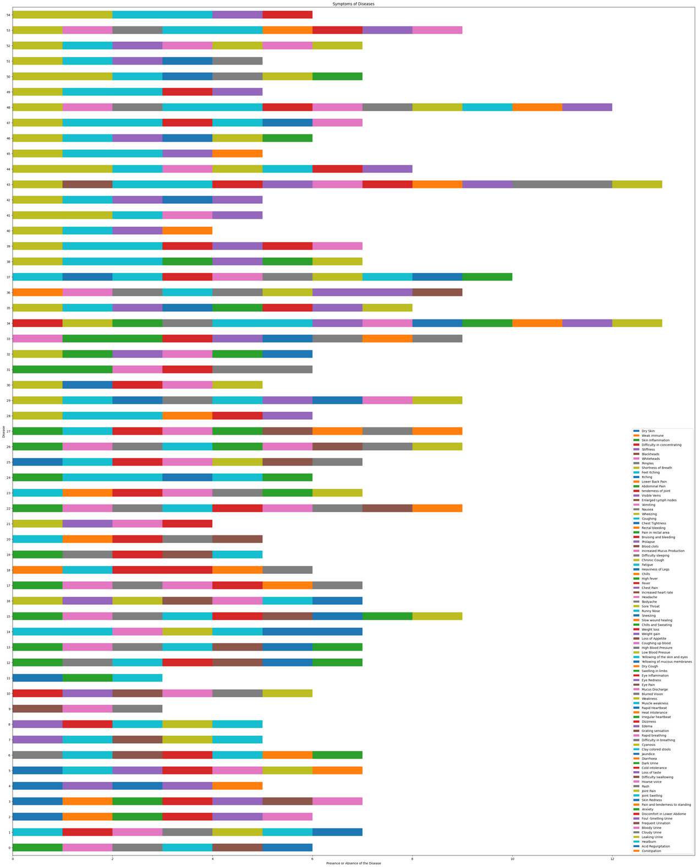
Horizontal Bar Graph
Reveals the frequency of symptoms associated with different diseases, aiding in identifying prevalent symptoms across conditions.
Fig 2: Horizontal Bar Graph (Diseases vs Count of Symptoms)

Slide 11
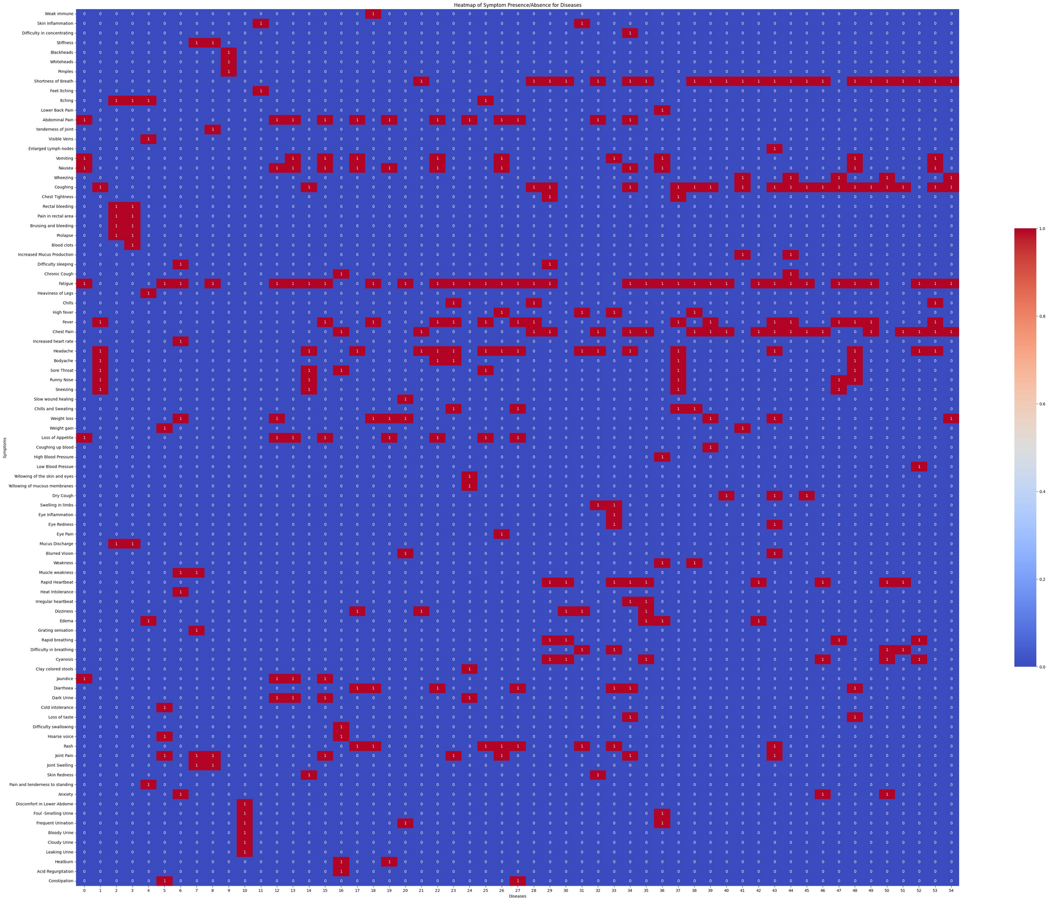
Heatmap
Visualizes the presence or absence of symptoms for each disease, allowing for a comprehensive overview of symptom occurrence patterns.
Fig 3: Heatmap (Symptom Presence/Absence for Diseases)

Slide 12
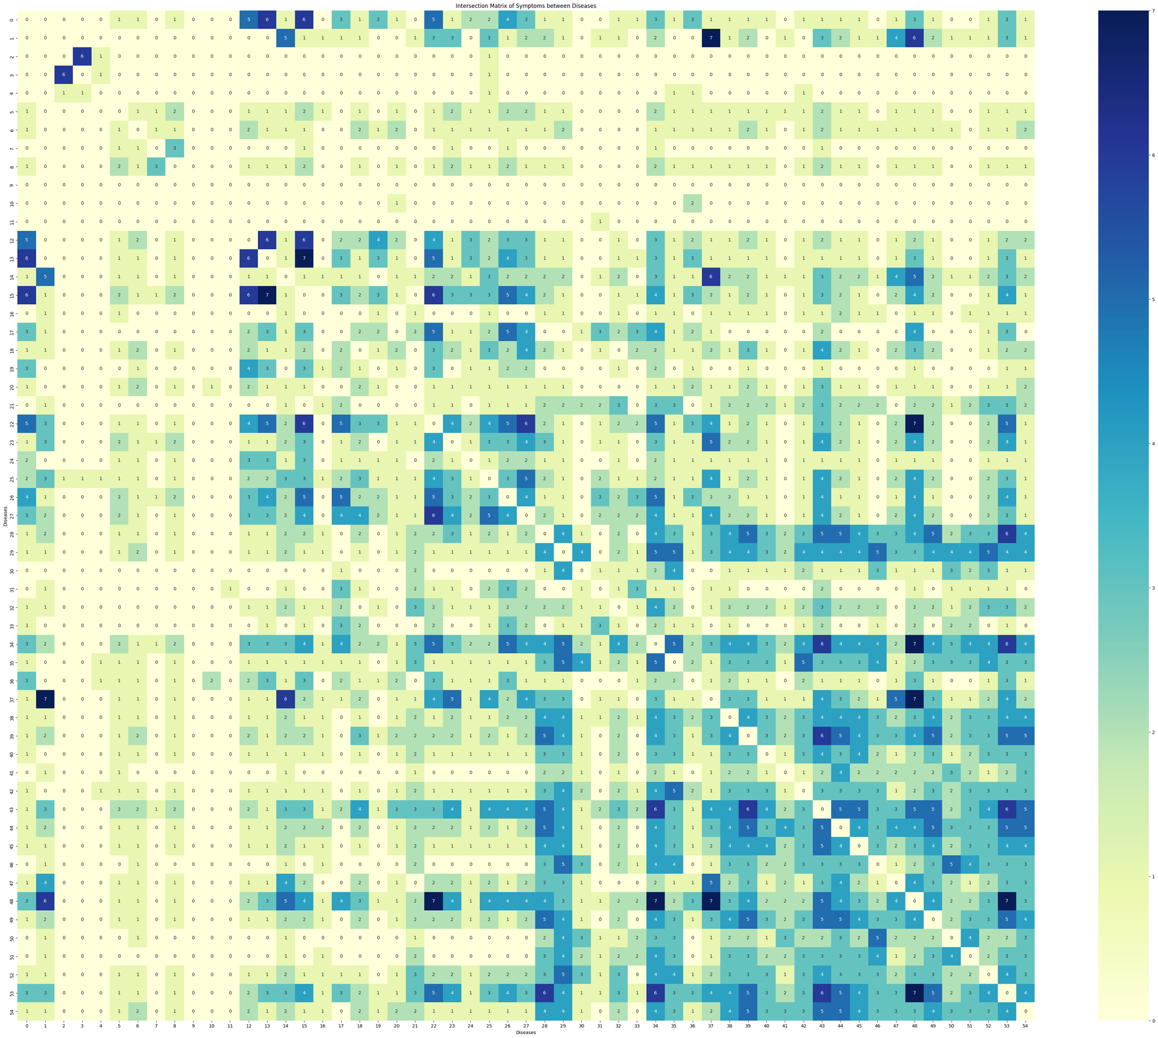
Intersection Matrix
Highlights overlaps between symptoms and diseases, offering insights into shared symptoms across various conditions.
Fig 4: Intersection Matrix Plot (Symptoms between Diseases)

Slide 13
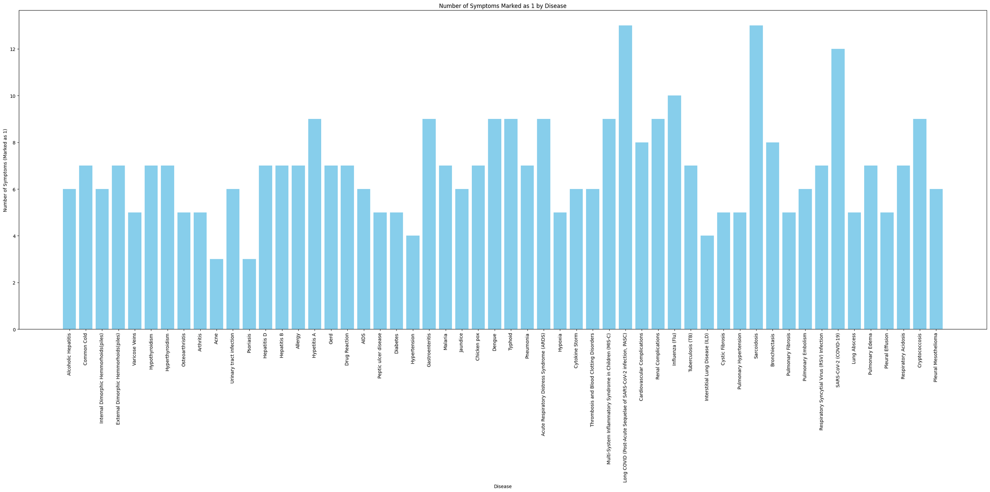
Vertical Bar Graph
Fig 5: Vertical Bar Graph Plot (Number of Symptoms vs Diseases)

Slide 14
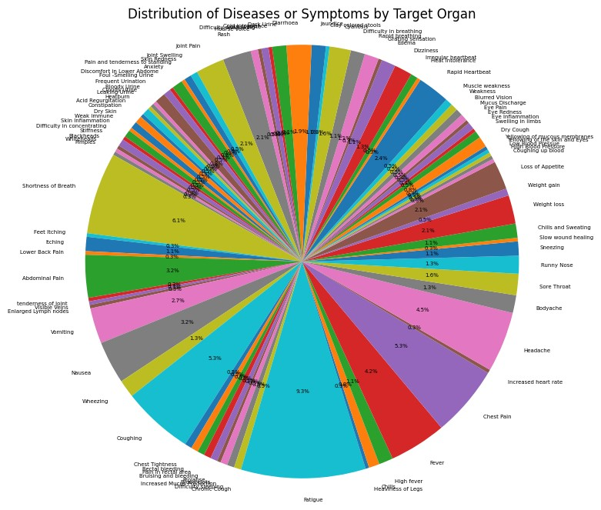
Pie Chart
Displays disease or symptom distribution categorized by target organs, offering a concise overview of organ-specific associations.
Fig 6: Pie Chart (Distribution of Diseases or Symptoms by Target Organ)

Slide 15
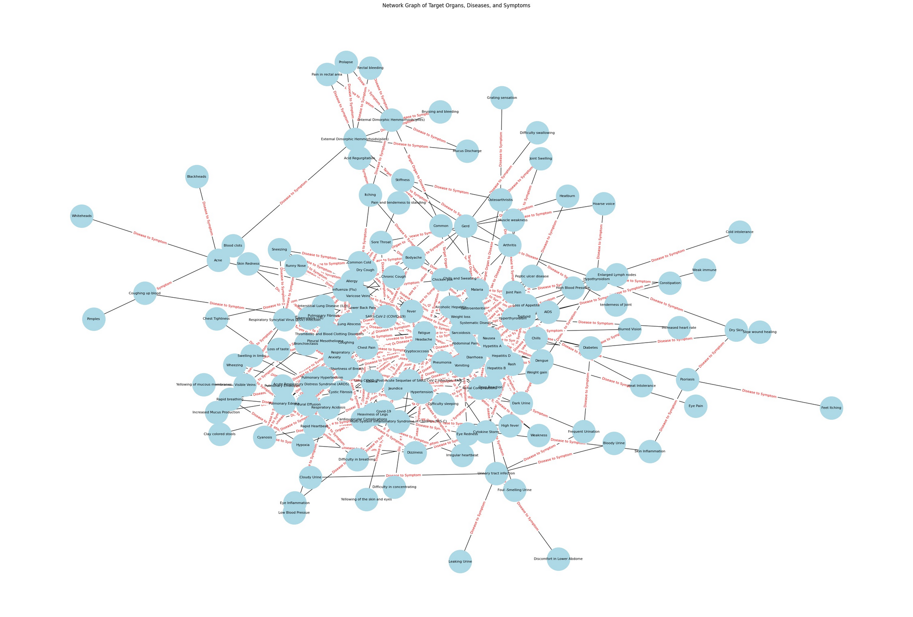
Network Graph
Establishes complex relationships between target organs, diseases, and symptoms, enabling the visualization of intricate connections within the dataset.
Fig 7: Network Graph (Connecting Target Organs, Diseases, and Symptoms)

Slide 16
ATTEMPTS OF
IMPLEMENTATION
Method 1 : Using Decision Tree
After implementing a medical expert system based on a decision tree model, the resulting tree's depth extended to an intricate 19 levels.
This depth raises concerns regarding model complexity, potential overfitting, and interpretability challenges. In response, a strategic shift in methodology is underway. Exploring alternative approaches, the focus has shifted towards ensembling methods such as random forest.
This technique, known for its ability to mitigate overfitting while preserving predictive power, appears promising for this context.

Slide 17
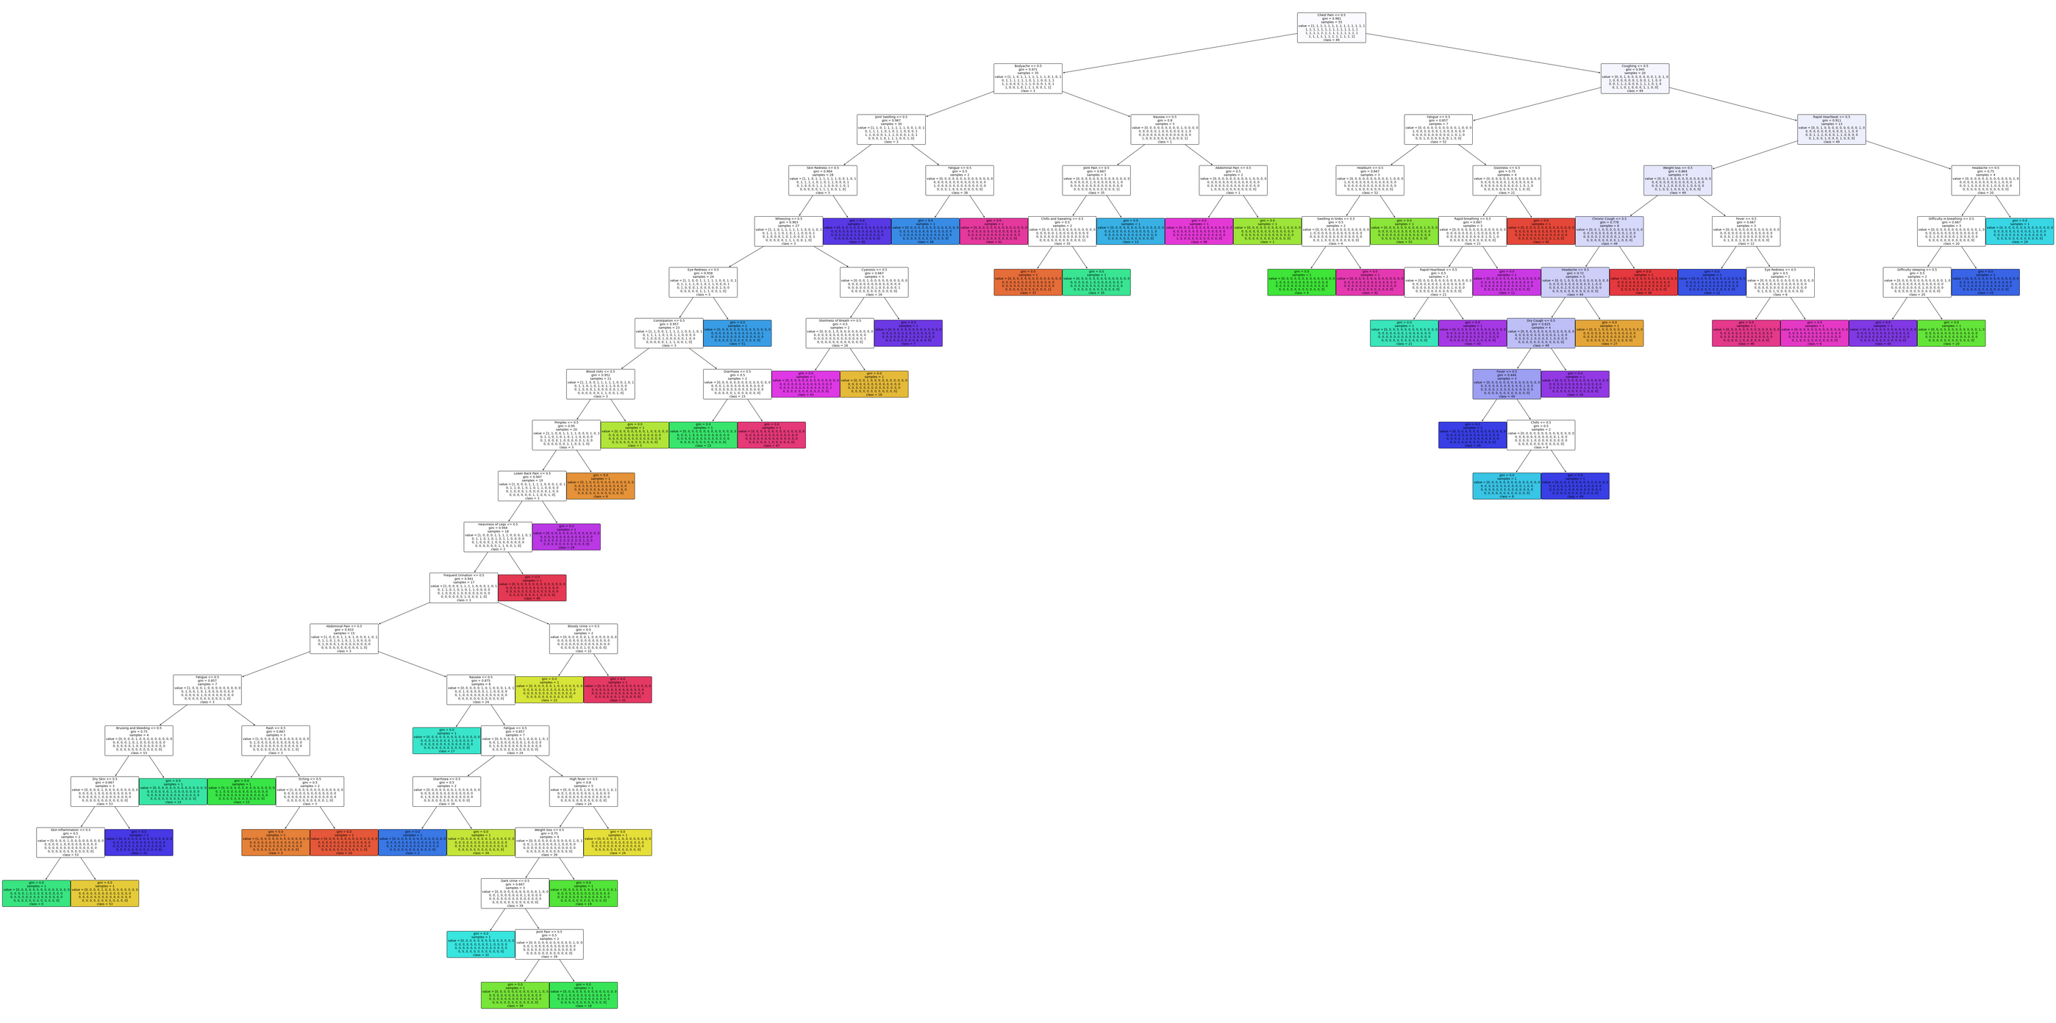
Using Decision Tree
Fig. 8: Decision Tree of depth 19 constructed for our dataset

Slide 18
ATTEMPTS OF
IMPLEMENTATION
Method 2: Using Random Forest
Upon transitioning from the decision tree to a random forest model, although a reduction in depth to 16 levels showed some improvement, concerns persisted regarding the inherent complexity of the random forest approach.
This complexity, while mitigated compared to the initial decision tree, remained a pivotal factor in seeking a more streamlined solution. As a strategic pivot, the focus has now shifted decisively towards a rule-based implementation.
This shift reflects a conscious effort to prioritize simplicity and interpretability without compromising predictive performance. Rule-based systems offer a structured and transparent framework that aligns closely with the intricate decision-making process required in medical applications.

Slide 19
ATTEMPTS OF
IMPLEMENTATION
Method 3: Rule-based Implementation
In our rule-based implementation, our primary focus revolves around optimizing user interaction by minimizing the number of questions posed while efficiently narrowing down the search space with each input iteration.
This approach aims to swiftly guide the user to the output by strategically reducing potential options based on their responses.
By intelligently structuring the questions and refining the search criteria in real-time, we streamline the user experience, ensuring that each query significantly diminishes the pool of potential outcomes.

Slide 20
PROPOSED METHODOLOGY
RULE-BASED SYSTEM
In our rule-based implementation, we streamline the user experience by initially presenting the top 8 symptoms most frequently occurring across various diseases, sorted in order of prevalence.
With each user selection, if the choice aligns with any of these top symptoms, the subsequent iteration displays the top 8 symptoms associated with diseases featuring the chosen symptom.
This strategic approach effectively diminishes the search space by focusing on symptoms closely linked to the user's selections, progressively refining and narrowing down potential disease options.

Slide 21
PROPOSED METHODOLOGY
RULE-BASED SYSTEM
In our diagnostic system, we determine the likelihood of a user's ailment by computing probabilities associated with specific diseases, aiding in assessing the severity of their illness.
If any calculated probability exceeds or equals 0.5, we present the top 5 probabilities to the user. However, if all probabilities remain below this threshold, we display all potential probabilities.
This approach offers a comprehensive view of potential illnesses, providing users with crucial insights into the likelihood and severity of their condition for informed decision-making.

Slide 22
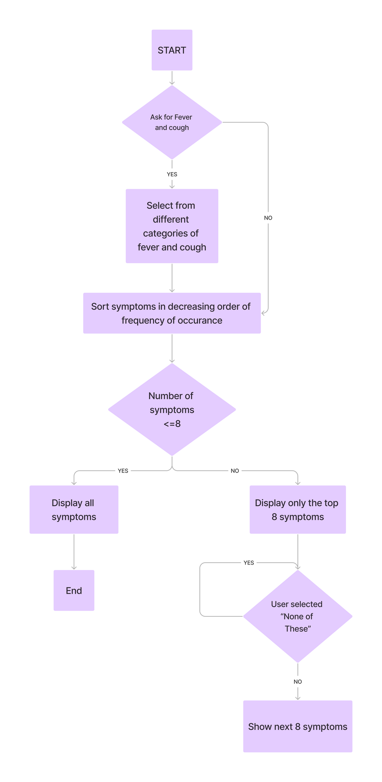
FLOWCHART OF
THE MEDICAL
EXPERT SYSTEM
The system engages in iterative, rule-based questioning, progressively reducing the question space by targeting specific symptoms and updating disease probabilities.
Fig 9: Flowchart depicting all the major steps of the implementation [1]

Slide 23
RESULTS
In our medical expert system, we've devised a dynamic approach to present potential diseases based on user-input symptoms and their associated probabilities.
When any disease surpasses a probability threshold of 0.5, we display the top 5 probable diseases to the user.
However, if all predicted probabilities remain below 0.5, we provide a comprehensive list encompassing all potential diseases. Moreover, for the specific case of COVID-19, we've categorized its severity into low, medium, and high levels.
For cases identified as low severity, we offer primary medications as recommendations. Conversely, in instances where the severity falls under medium or high categories, we strongly advise immediate consultation with a healthcare professional for further evaluation and guidance.

Slide 24
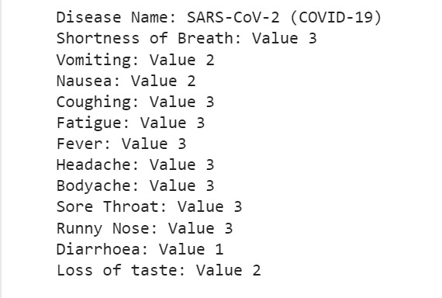
RESULTS
RUNNING THE RULE-BASED APPROACH
Fig. 10 Mimicking the symptoms of Covid-19 and running our rule-based approach

Slide 25
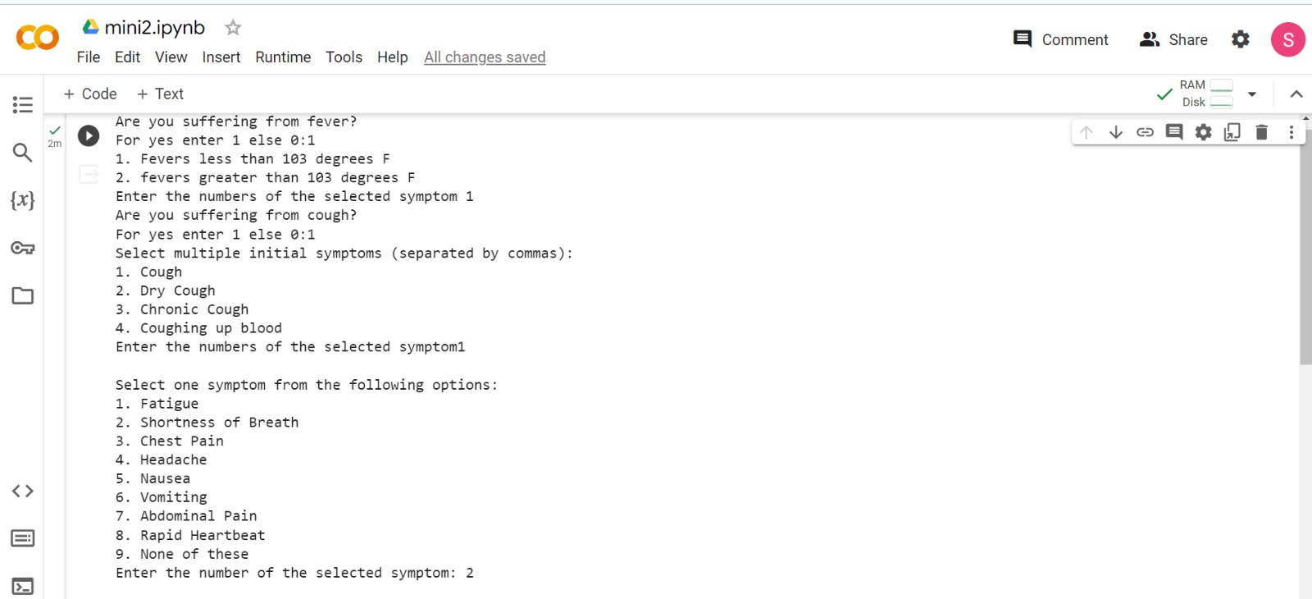
Fig. 11

Slide 26
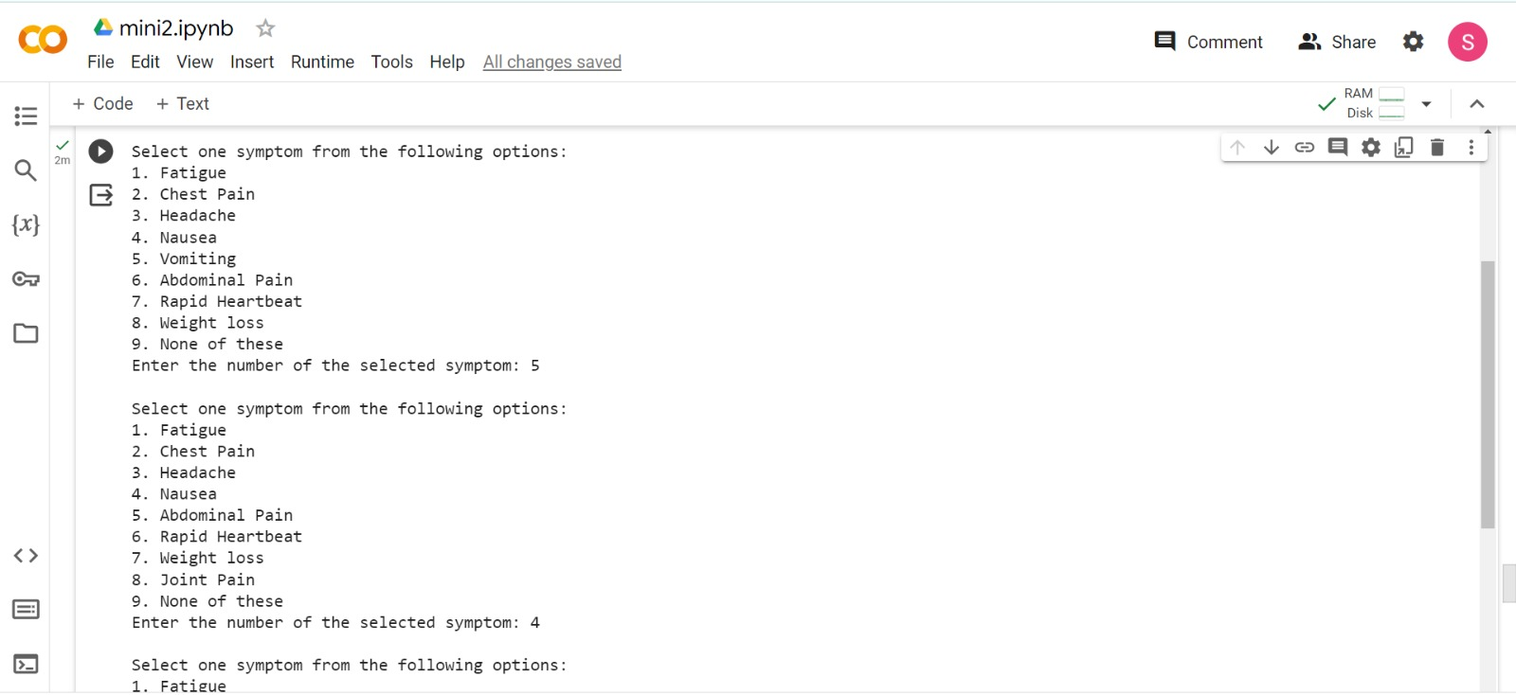
Fig. 12

Slide 27
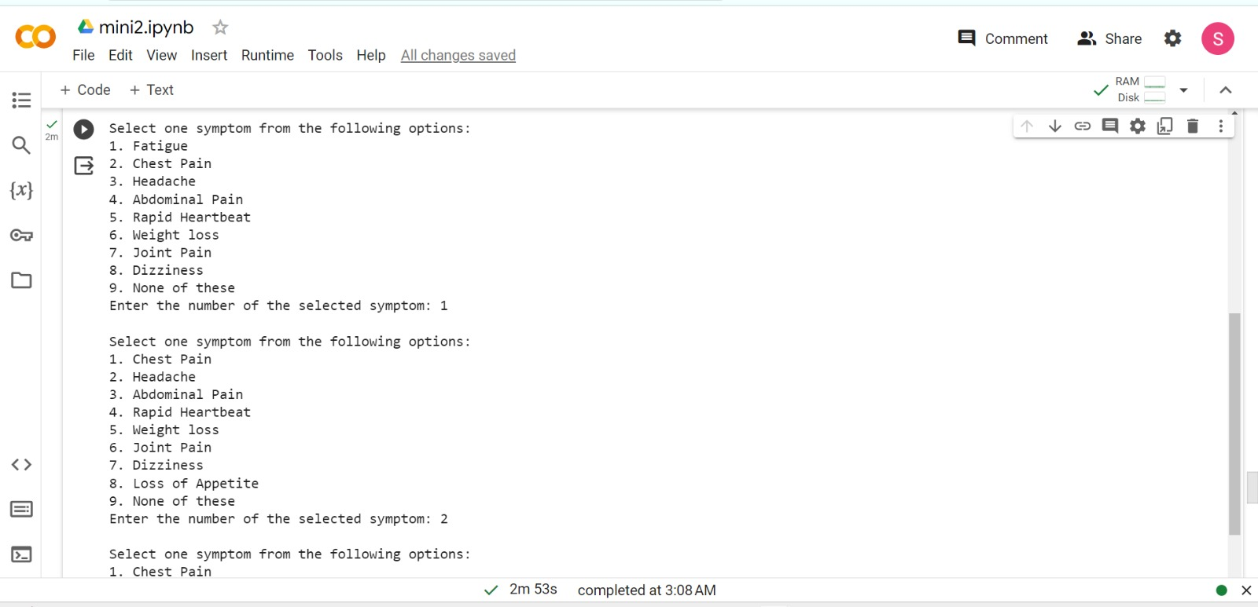
Fig. 13

Slide 29
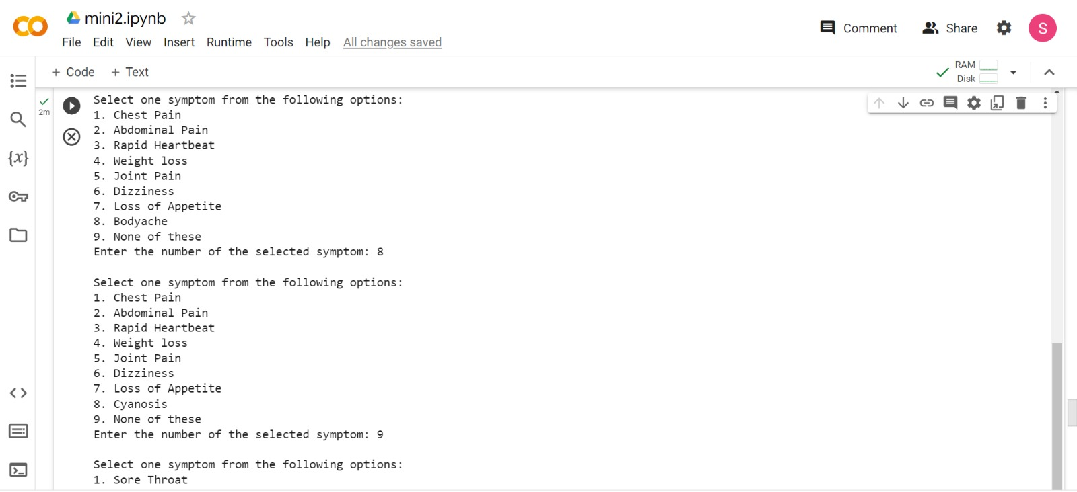
Fig. 14

Slide 30
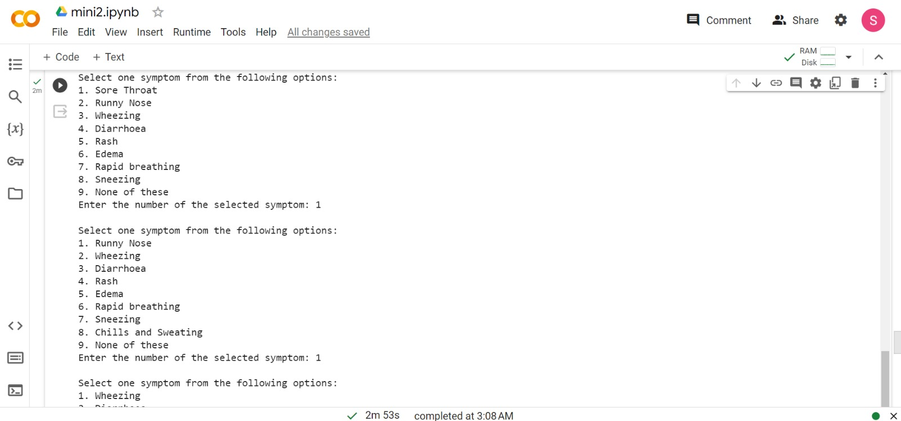
Fig. 15

Slide 31
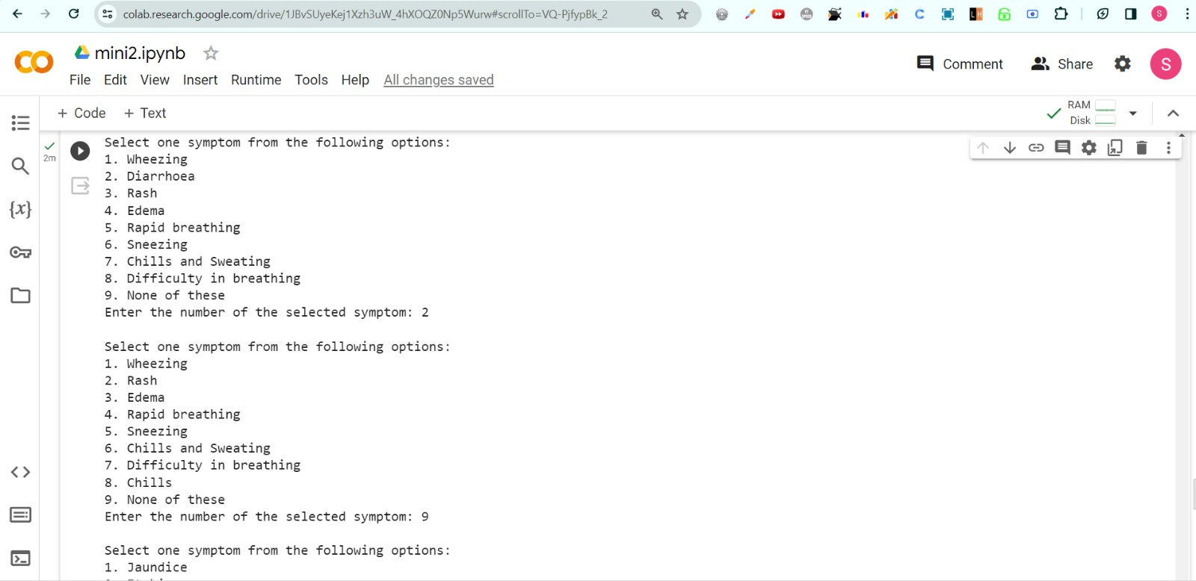
Fig. 16

Slide 32
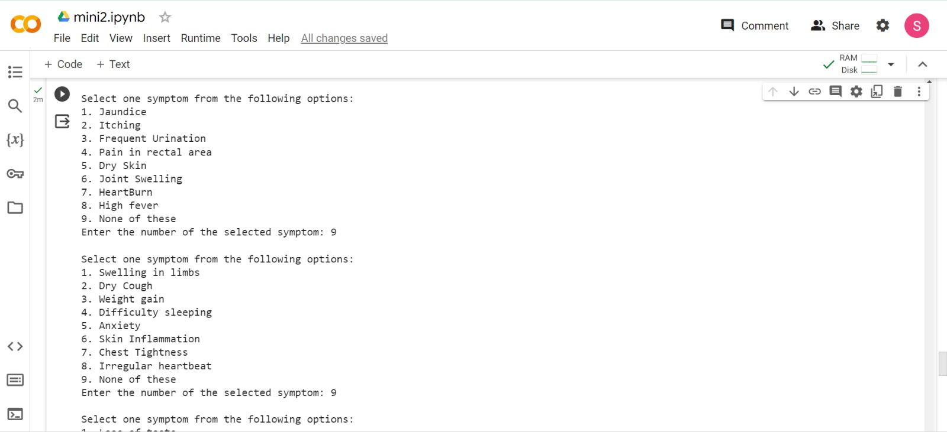
Fig. 17

Slide 33
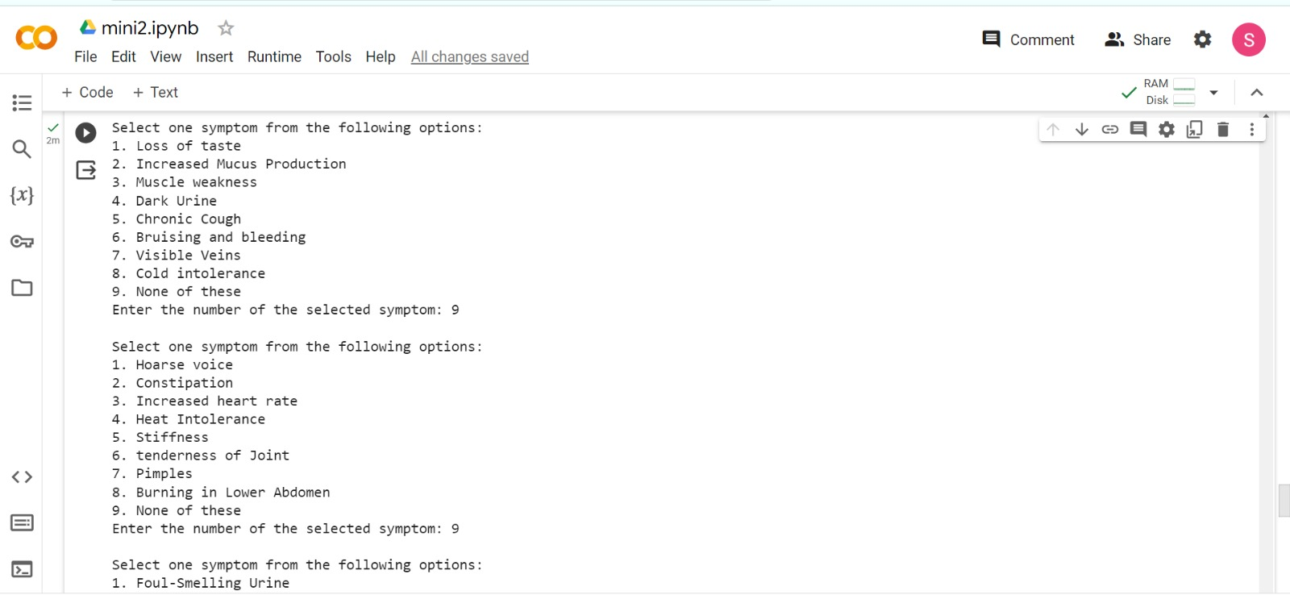
Fig. 18

Slide 34
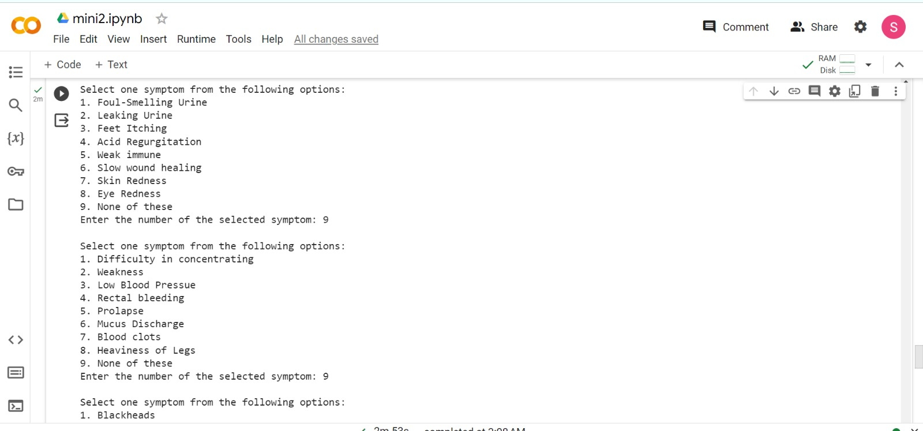
Fig. 19

Slide 35
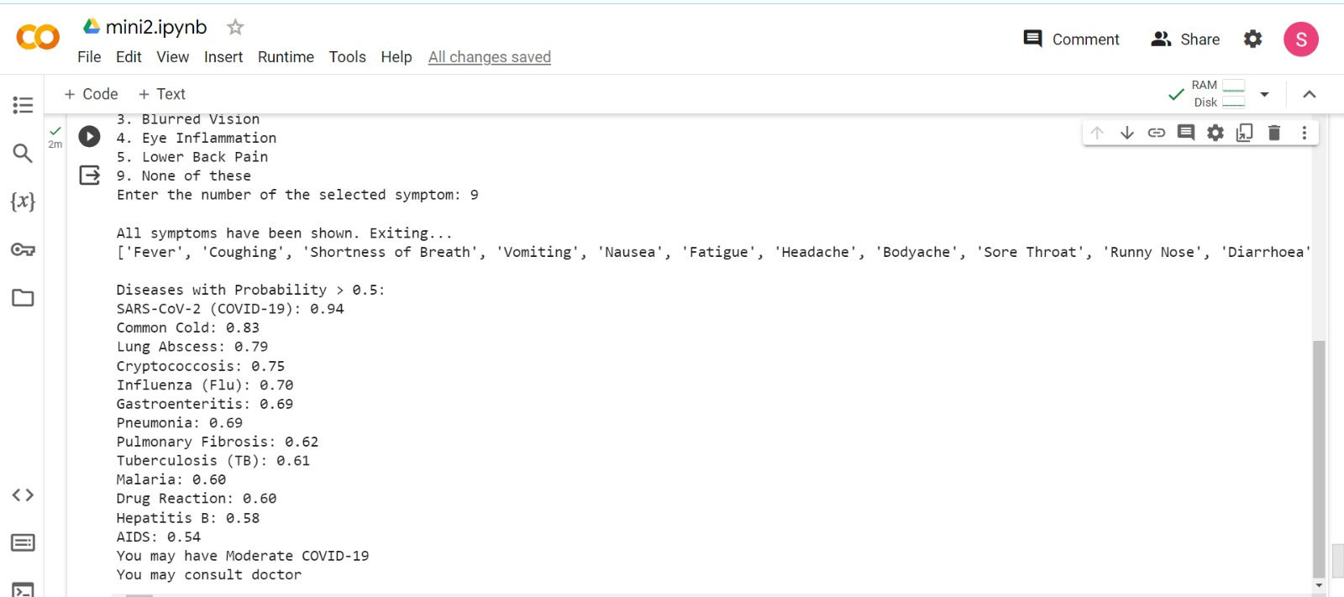
Fig. 20

Slide 36
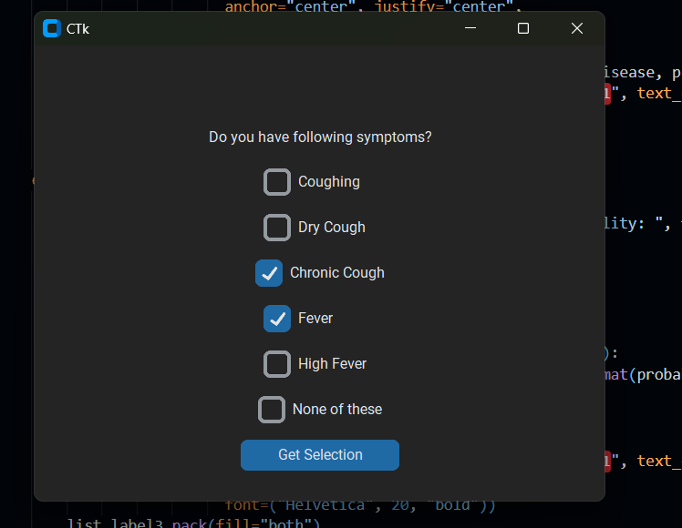
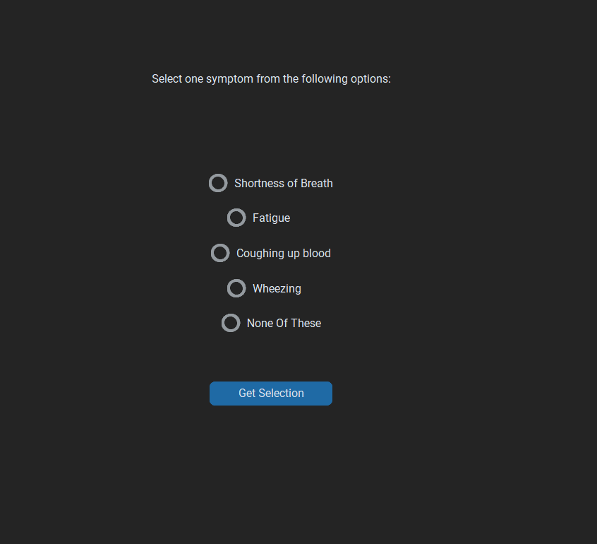
RESULTS
GUI IMPLEMENTATION
Fig. 21 Taking input from user using GUI Implementation

Slide 37
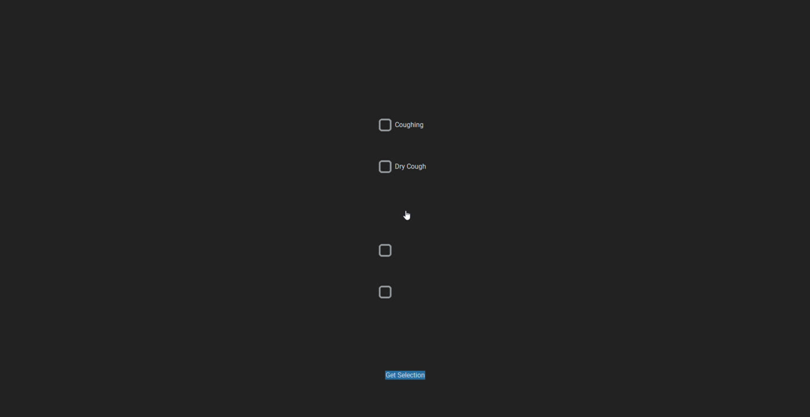
Video. 1 Walkthrough of Project

Slide 38
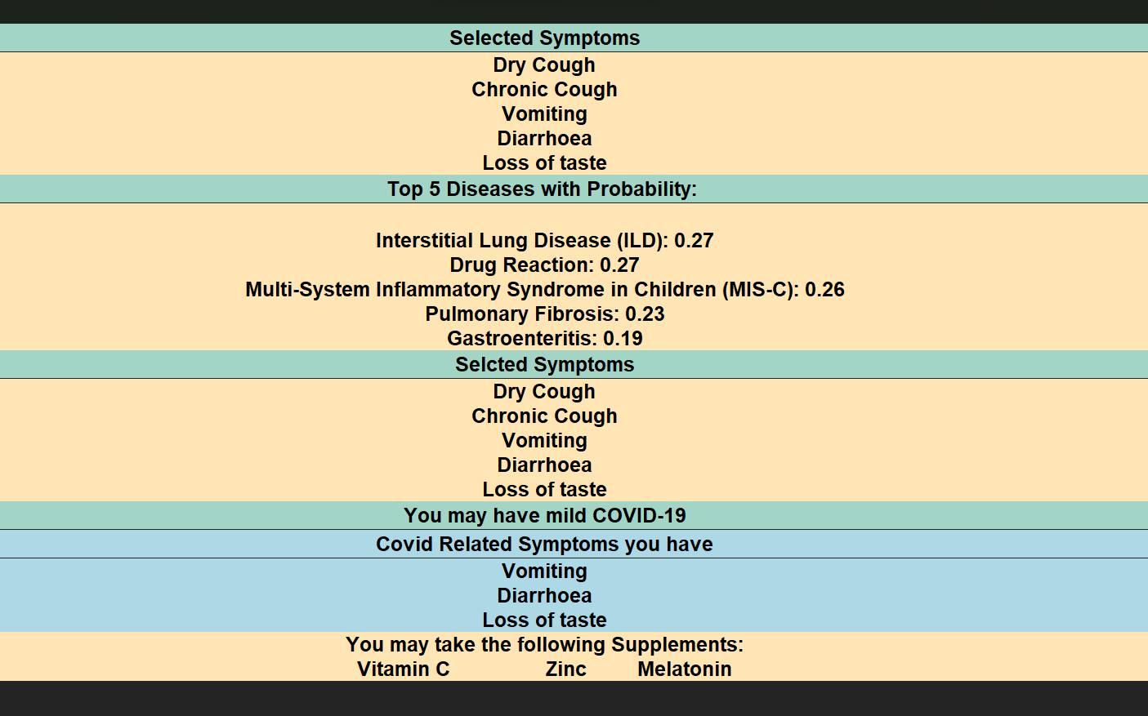
RESULTS
GUI
IMPLEMENTATION
Fig. 22 Output of GUI Implementation

Slide 39
FUTURE
SCOPE
Expand Disease Database: Include a broader range of diseases covering various organs and systems to enhance diagnostic capabilities.
Incorporate Medical Imaging Data: Integrate X-rays, MRI scans, and lab reports into machine learning algorithms for more accurate disease prediction.
Focus on Demographics:
Pediatric Diseases: Develop specialized algorithms for predicting diseases specific to children, considering their unique physiology.
Women's Health: Address gynecological conditions and reproductive health to better serve women's healthcare needs.
Elderly Health: Tailor the system to detect age-related illnesses, geriatric syndromes, and chronic conditions prevalent in the elderly.

Slide 40
In summary, our medical expert system combines rule-based algorithms and probability assessments to efficiently identify potential diseases based on user symptoms.
Additionally, our system categorizes COVID-19 severity and recommends primary medications for low severity, urging consultation for medium to high severity cases.
This technology aims to streamline initial healthcare assessments while emphasizing the importance of professional guidance in critical situations
CONCLUSION

Slide 41
Collection of dataset
ACTIVITY
TIMECHART
Consultation with doctor, updation of dataset and marking the probability of diseases X symptoms
Implementation of code and predicting diseases with probability based on symptoms

Slide 42
ACKNOWLEDGEMENTS
We convey our sincerest gratitude to Vrijendra sir, Trapti ma’am for guiding, supporting and motivating us throughout the course of the project, their inputs have been the guiding light for us throughout the implementation of the project.
We extend our sincere gratitude to Dr. Shambhavi Kumari, [M.B.B.S.], Dr. Bijal Salvi, [M.B.B.S], Dr. Praful Salvi, [M.D. Anaesthesia], Dr. Daraksha Naaz [M.B.B.S.], Dr. Rupali Singh [M.B.B.S.] for their invaluable support and expertise in providing insightful feedback and guidance during the development of our disease-symptoms dataset. Their suggestions and assistance in assigning probabilities to individual symptoms have been instrumental in enhancing the quality and accuracy of our implementation.

Slide 43
REFERENCES
[1] Yadav, A. K., Shukla, R., & Singh, T. R. (2021). "Machine Learning in Expert Systems for Disease Diagnostics in Human Healthcare." In Book Title (pp. 179-200). Publisher. DOI: 10.1016/B978-0-12-821777-1.00022-7.
[2] Latif, J., Xiao, C., Tu, S., Rehman, S. U., Imran, A., & Bilal, A. (2020). "Implementation and Use of Disease Diagnosis Systems for Electronic Medical Records Based on Machine Learning: A Complete Review." DOI: 10.1109/ACCESS.2020.3016782.
[3] Nayak, R., & Boloor, A. (2018). Exam Preparatory Manual for Undergraduates—Medicine (2nd ed.). Publisher. DOI: 10.5005/jp/books/18461
[4] https://www.msdmanuals.com/en-in/home/health-topics

Slide 44
THANK YOU!

